Slide 1
Intro to Cybersecurity
By Axel Reyes

Slide 2


Are your accounts really secure?
Do you make strong passwords?
Do share your information online?

Slide 3


What is a Brute Force Attack?
Guessing over and over again for the correct credentials using information you learn as you make more attempts
An example is trying every combination of a padlock

Slide 4

Dictionary Attack
A common type of Brute Force attack that guesses using common words in a dictionary or forgotten/common passwords rather than random strings but together

Slide 5


How to defend against it?
Many people use common phrases for passwords and the same username for different platforms
2fa - 2 factor authentication prevents even people who can guess your credentials for even logging in
Use complex passwords that are uncommon

Slide 6

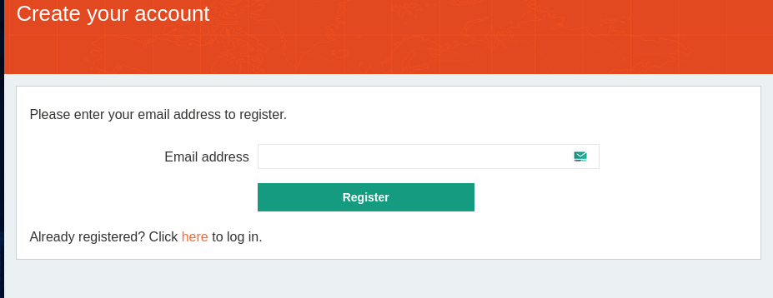
Objective: Brute force Attack a Blog
Let’s see how easy it to perform a Brute Force Attack
Make an account on Portswigger
Download Burpsuite Community Edition

Slide 7

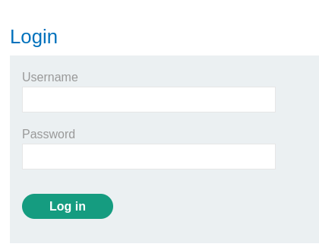
Target site: Blog
Make your way over to the vulnerable Blog site

Slide 8
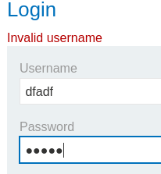
Look carefully!
Attempt to log in
What information does this website tell you
Here we know that the entered username is
Invalid and therefore the website will tell us
If a username we enter is valid

Slide 9

I can see that we don’t have the proper credentials!
If we guess enough random usernames we might be able to find one that works for us from a person that put a simple username like “user” or “admin” or “JaneDoe”

Slide 10
Tools to make our life easier!
Burpsuite lets us automate our hacking tasks while providing extra information to us!
First step is to start up Burpsuite and navigate to the proxy tab

Slide 11
Make sure Intercept is off and click Open Browser to use Burpsuite’s built in browser

Slide 12
Navigate to the “HTTP history” tab
Open the Blog site in the Burpsuite Browser and attempt to log in
You will see an entry appear with POST under the Method column and a ‘/login’ under the URL column

Slide 13
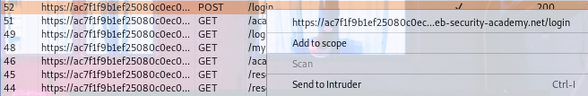
Right click the entry and select the “Send to Intruder” option
Navigate to the Intruder tab to the right of the proxy tab

Slide 14
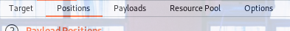
Automation time!
Now we setup burpsuite to do the guessing for us!
Navigate to the “positions” Tab within “Intruder”

Slide 15
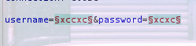
You will be see lots of things going on, but relax! Try to focus on the bottom of the page
This small section dictates what information you’re going to send to this website’s server
You’ll notice that it’s the same information from when you attempted to login

Slide 16

If you click the ‘Clear §’ button you’ll remove all those § symbols from the page
They serve as place holder for inserting data like several usernames and passwords!
Highlight the text set to equal “username” and click “Add §”
- It should look like this username=§random_username§

Slide 17
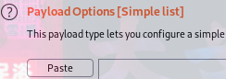
Switch over to the payloads tab
Go to this link to copy all of the generic usernames and paste them with the “Past” button under Payload Options

Slide 18
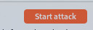
On the top right of the screen hit “Start Attack”
Burp suite is now sending a POST request the same way you did, but it’s automatically testing a list of usernames for you one by one! Isn’t that great?

Slide 19
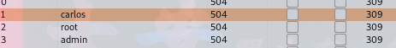
You’ll see a screen similar to this
All of these are entries like the one you did at the start and they’re all wrong except for one
Be on the lookout for an entry with a unique Length value
This can indicate that the response from the website was different and not just a “wrong username”

Slide 20
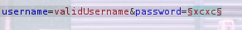
When you get a unique response it means you found a valid username
Take your new found username and paste it into the Intruder-Positions section’s “username= “ area and repeat the steps but for the password section
After doing this for username and password you will have found a valid set of credentials and can attempt to login!

Slide 21
Thank You For
Listening!

